Slide 1
Category review: Chips
June 2025
Retail Analytics
Brand note: If client logo is not required, use alternate title page layout right click slide thumbnail > Layout > Title

Slide 2
Notes:
To view Privacy video explaining how important data privacy is to Quantium, please click here: https://www.youtube.com/watch?v=Zq1QDAkoRzU
or here Q:\Company Reference\Brand & Design\Brand videos\Q Privacy.mp4
At Quantium, we believe that data is the behavioural footprint of humanity and that it has to be treated with the utmost care and responsibility.
Histories, attitudes, indeed lives are stored within it in ways that aren’t always apparent – and that’s what makes its potential so powerful.
To work with it responsibly, sensitively, we set ourselves the highest data privacy protection and governance standards.
We have spent 17 years perfecting privacy-by-design and secure-by-design principles. Central to this is not holding any personally identifiable information about people –
we neither receive it, and put the necessary protections in place to be unable to decipher it.
Every aspect of handling data is safeguarded: from its de-identification, to its encryption – data security is paramount and of the highest grade.
We pride ourselves on gaining the trust of iconic organisations around the world through years of securely working with their data,
and in turn the trust that builds with their stakeholders.

Slide 3
Executive summary
01
Task 1
Top Buyer Segments:
Budget – Older Families
Mainstream – Young Singles/Couples
Mainstream – Retirees
Mainstream Young Singles/Couples and Retirees are high spenders and primary shoppers of chips
Mainstream Young & Mid-Age Singles/Couples are more likely to pay premium prices per packet
Mainstream Young Singles/Couples are 23% more likely to purchase Tyrrells Brand chips than the other population
02
Task 2
A control store was constructed to reflect the prior performance of the selected trial store.
Found control stores 233, 155, 237 for trial stores 77, 86 and 88 respectively
Trial Stores 77 and 88:
Showed a statistically significant difference from the control stores during the trial period
Trial Store 86:
No significant difference detected across the trial period from the control store

Slide 4
01
Category

Slide 5
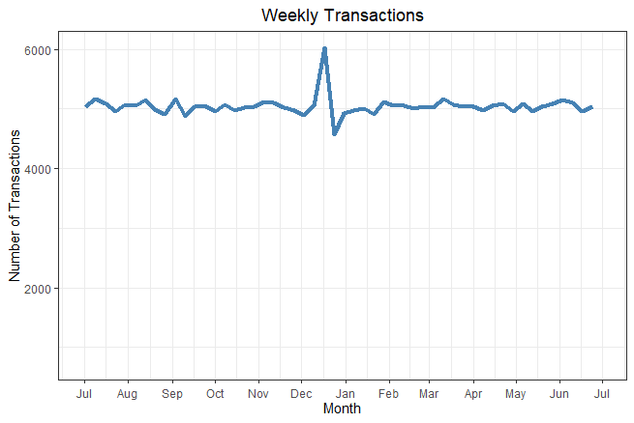
Sales dipped on Christmas Day, likely due to store closures
Explaining the spike observed in the preceding week, returning to normal levels after the holidays

Slide 6
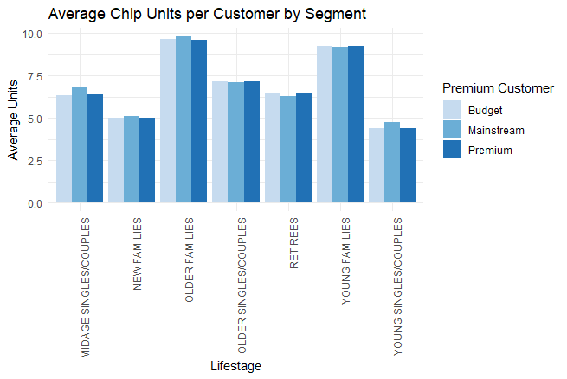
Affluence levels are consistent across life stage profiles
Notably, Older and Young Family shoppers lead in average units purchased per transaction, highlighting their higher engagement and potential value

Slide 7
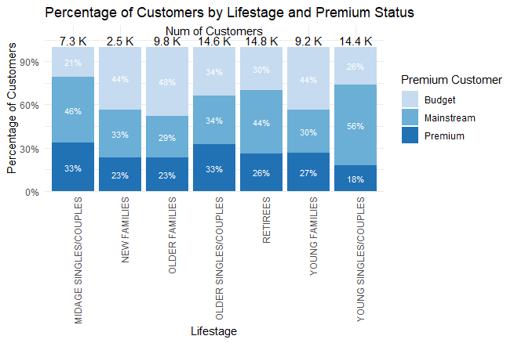
Editable (delete this)
Mainstream Young Singles & Couples represent the largest segment of Snacking Chips shoppers
Mainstream Retirees also hold a notable share—indicating strong cross-generational appeal within the mainstream group

Slide 8
02
Trial store performance

Slide 9
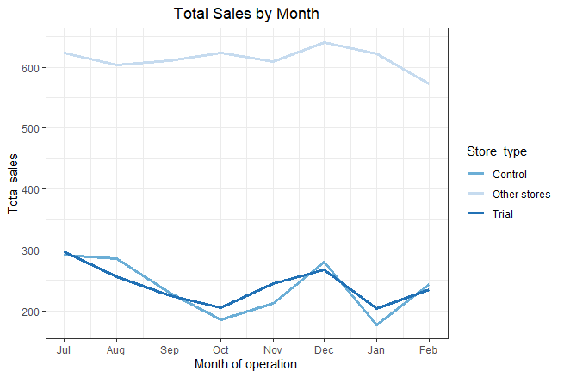
Control Store 233 is specifically designed to mirror the performance of Trial Store 77
While sales patterns differ slightly, this pairing provides a more accurate benchmark for evaluating the trial’s impact

Slide 10
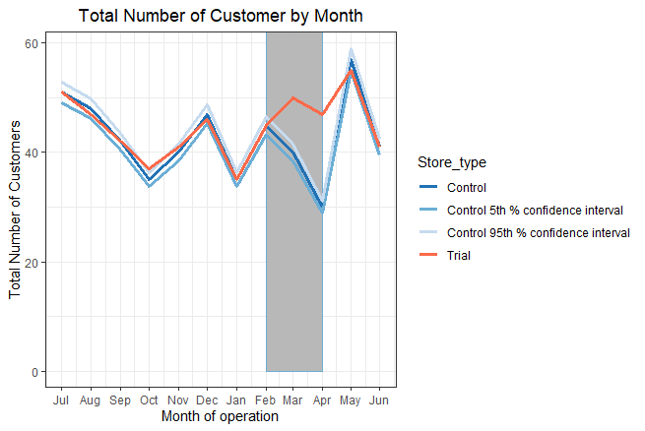
From February to May, the trial store consistently outperformed the control store, underscoring the effectiveness of the new store layout in driving customer engagement

